Slide 1
Quiz
“CST370-S19_Quiz_4” on iLearn.
password is “goldfish”
Pick up a worksheet when you’ve completed the quiz.
Notes:
Let’s start with a game: sorting numbers! Do this without writing things down. You have 5 seconds.
Human sorting activity: show numbers of items and list of items
(5min)

Slide 2
CST 370 – ADVANCED ALGORITHMS
6.1 Other techniques for approximating Big O
Notes:
Today we’re going to talk about time complexity

Slide 3
Objectives
You will be able to…
Approximate the Big O of algorithms by reasoning about input access.
Approximate the Big O of recursive algorithms by reasoning about the recursion tree.
Calculate the Big O of recursive algorithms by defining and solving a Recurrence Relation.
Notes:
So this second mini-lesson will be more of a lab-style. We’re going to practice identifying the time and space complexities of simple algorithms by a method where we count operators.

Slide 4
Computational Complexity
Definition
Computational complexity refers to how efficient the algorithm is as it scales to larger and larger inputs.
Notes:
To answer this question, let's think about why we use computers instead of people to solve problems.
Human sorting activity: show numbers of items and list of items

Slide 5
Computational Complexity
Definition
Computational complexity refers to how efficient the algorithm is as it scales to larger and larger inputs.
Time complexity refers to how the number of operations it takes to run the algorithm is related to its input size.
Space complexity refers to how the amount of additional memory an algorithm consumes is related to its input size.
Notes:
To answer this question, let's think about why we use computers instead of people to solve problems.
Human sorting activity: show numbers of items and list of items

Slide 6
Big O Notation
Informal Definition
O(n): Read this as “Big O of n.” Assume n represents a mathematical expression.
Notes:
To answer this question, let's think about why we use computers instead of people to solve problems.
Human sorting activity: show numbers of items and list of items

Slide 7
Big O Notation
Informal Definition
O(n): Read this as “Big O of n.” Assume n represents a mathematical expression.
Big O is an approximation that tells us about an algorithm’s worst-case scenario use of time or space.
Notes:
To answer this question, let's think about why we use computers instead of people to solve problems.
Human sorting activity: show numbers of items and list of items

Slide 8
Big O Notation
Informal Definition
O(n): Read this as “Big O of n.” Assume n represents a mathematical expression.
O(n) time means an algorithm takes approximately n operations at most to run.
O(n) space means an algorithm consumes approximately n units of memory at most to run.
Notes:
To answer this question, let's think about why we use computers instead of people to solve problems.
Human sorting activity: show numbers of items and list of items

Slide 9
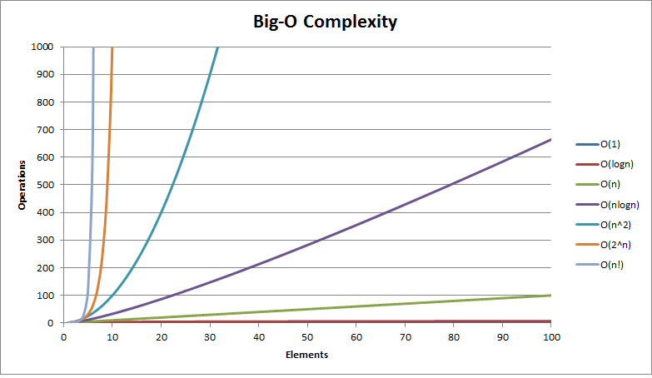
Common Complexity Classes
A graph of input size to operations

Slide 10
Calculating Big O: Counting Operators
Algorithm
Independently evaluate each line, counting how many times it runs relative the input size.
Combine nested loop complexities:
Sum complexities in innermost loop body.
Drop all constants and lesser terms from the sum.
Multiply the complexities of the loop and the loop body.
Drop all constants and lesser terms from the product.
Repeat steps a-d for the next loop (if applicable) working your way out.
Add complexities for all top-level operations.
Drop all constants and lesser terms from the sum.

Slide 11
Calculating Big O: Other Methods
An approximation technique.
Reasoning about input access.
How many elements in the input does our algorithm access?
How many operations / much memory does it take to run when we access an element?

Slide 12
Calculating Big O: Other Methods
A more mathematical technique.
Creating and solving a Recurrence Relation.
Create a set of equations to describe the complexity of a recursive algorithm.
Solve the set of equations (probably using logarithms)

Slide 13
Calculating Big O: Other Methods
Another approximation technique.
Reasoning about the recursion tree.
Look at a tree of recursive calls and estimate the Big O at each level of the recursion tree.
Useful for approximating recursive algorithms.

Slide 14
Merge Sort: merge
What is the Big O?
void merge(vector<int> &vec, int l, int m, int r) {
auto left = vector<int>();
auto right = vector<int>();
for (int i = l; i <=m; i++)
left.push_back(vec[i]);
for (int i = m+1; i <= r; i++)
right.push_back(vec[i]);
int li = 0;
int ri = 0;
int i = l;
while (li < left.size() && ri < right.size()) {
if (left[li] < right[ri]) {
vec[i] = left[li];
i++;
li++;
} else {
vec[i] = right[ri];
i++;
ri++;
}
}
while (li < left.size()) {
vec[i] = left[li];
i++;
li++;
}
while (ri < right.size()) {
vec[i] = right[ri];
i++;
ri++;
}
}

Slide 15
Merge Sort: merge
What is the input size?
void merge(vector<int> &vec, int l, int m, int r) {
auto left = vector<int>();
auto right = vector<int>();
for (int i = l; i <=m; i++)
left.push_back(vec[i]);
for (int i = m+1; i <= r; i++)
right.push_back(vec[i]);
int li = 0;
int ri = 0;
int i = l;
while (li < left.size() && ri < right.size()) {
if (left[li] < right[ri]) {
vec[i] = left[li];
i++;
li++;
} else {
vec[i] = right[ri];
i++;
ri++;
}
}
while (li < left.size()) {
vec[i] = left[li];
i++;
li++;
}
while (ri < right.size()) {
vec[i] = right[ri];
i++;
ri++;
}
}

Slide 16
Merge Sort: merge
What is the input size?
void merge(vector<int> &vec, int l, int m, int r) {
auto left = vector<int>();
auto right = vector<int>();
for (int i = l; i <=m; i++)
left.push_back(vec[i]);
for (int i = m+1; i <= r; i++)
right.push_back(vec[i]);
int li = 0;
int ri = 0;
int i = l;
while (li < left.size() && ri < right.size()) {
if (left[li] < right[ri]) {
vec[i] = left[li];
i++;
li++;
} else {
vec[i] = right[ri];
i++;
ri++;
}
}
while (li < left.size()) {
vec[i] = left[li];
i++;
li++;
}
while (ri < right.size()) {
vec[i] = right[ri];
i++;
ri++;
}
}
O(n) where n is the difference between r and l.

Slide 17
Merge Sort: merge
How many elements do we access?
void merge(vector<int> &vec, int l, int m, int r) {
auto left = vector<int>();
auto right = vector<int>();
for (int i = l; i <=m; i++)
left.push_back(vec[i]);
for (int i = m+1; i <= r; i++)
right.push_back(vec[i]);
int li = 0;
int ri = 0;
int i = l;
while (li < left.size() && ri < right.size()) {
if (left[li] < right[ri]) {
vec[i] = left[li];
i++;
li++;
} else {
vec[i] = right[ri];
i++;
ri++;
}
}
while (li < left.size()) {
vec[i] = left[li];
i++;
li++;
}
while (ri < right.size()) {
vec[i] = right[ri];
i++;
ri++;
}
}
We access everything in left and right once.
Notes:
We visit everything in left and right once.

Slide 18
Merge Sort: merge
How many elements do we access?
void merge(vector<int> &vec, int l, int m, int r) {
auto left = vector<int>();
auto right = vector<int>();
for (int i = l; i <=m; i++)
left.push_back(vec[i]);
for (int i = m+1; i <= r; i++)
right.push_back(vec[i]);
int li = 0;
int ri = 0;
int i = l;
while (li < left.size() && ri < right.size()) {
if (left[li] < right[ri]) {
vec[i] = left[li];
i++;
li++;
} else {
vec[i] = right[ri];
i++;
ri++;
}
}
while (li < left.size()) {
vec[i] = left[li];
i++;
li++;
}
while (ri < right.size()) {
vec[i] = right[ri];
i++;
ri++;
}
}
left.size() + right.size() = r - l

Slide 19
Merge Sort: merge
How many elements do we access?
void merge(vector<int> &vec, int l, int m, int r) {
auto left = vector<int>();
auto right = vector<int>();
for (int i = l; i <=m; i++)
left.push_back(vec[i]);
for (int i = m+1; i <= r; i++)
right.push_back(vec[i]);
int li = 0;
int ri = 0;
int i = l;
while (li < left.size() && ri < right.size()) {
if (left[li] < right[ri]) {
vec[i] = left[li];
i++;
li++;
} else {
vec[i] = right[ri];
i++;
ri++;
}
}
while (li < left.size()) {
vec[i] = left[li];
i++;
li++;
}
while (ri < right.size()) {
vec[i] = right[ri];
i++;
ri++;
}
}
left.size() + right.size() = r - l
O(n) where n is the difference between r and l.

Slide 20
Merge Sort: merge
How many elements do we access?
void merge(vector<int> &vec, int l, int m, int r) {
auto left = vector<int>();
auto right = vector<int>();
for (int i = l; i <=m; i++)
left.push_back(vec[i]);
for (int i = m+1; i <= r; i++)
right.push_back(vec[i]);
int li = 0;
int ri = 0;
int i = l;
while (li < left.size() && ri < right.size()) {
if (left[li] < right[ri]) {
vec[i] = left[li];
i++;
li++;
} else {
vec[i] = right[ri];
i++;
ri++;
}
}
while (li < left.size()) {
vec[i] = left[li];
i++;
li++;
}
while (ri < right.size()) {
vec[i] = right[ri];
i++;
ri++;
}
}
Total time complexity: O(n)

Slide 21
Calculating Big O: Input Access
An approximation technique.
Reasoning about input access.
How many elements in the input does our algorithm access?
How many operations / much memory does it take to run when we access an element?

Slide 22
Calculating Big O: Recurrences
A more mathematical technique.
Creating and solving a Recurrence Relation.
Create a set of equations to describe the complexity of a recursive algorithm.
Solve the set of equations (probably using logarithms)

Slide 23
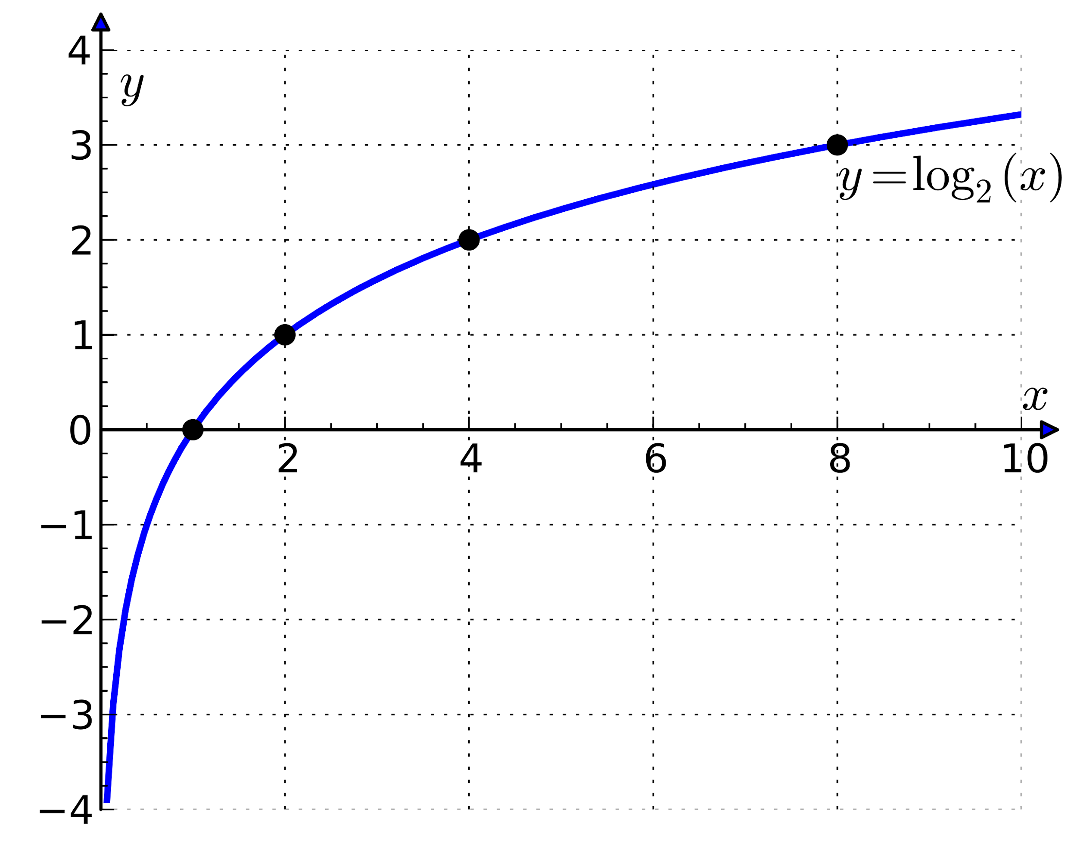
Calculating Big O: Recurrences
A mathematical refresher.
Logarthims: Used when you divide by a constant repeatedly.
log_{a}(x)= b if and only if a^{b} = x
log_{a}(x/y)= log_{a}(x) - log_{a}(y)
log(n) almost always means log₂(n) in computer science.

Slide 24
Merge Sort: sort
Merge Sort
void mergeSort(vector<int> &vec, int l, int r) {
if (r - l > 0) { // O(1)
int m = (l + r) / 2; // O(1)
mergeSort(vec, l, m); // ????
mergeSort(vec, m + 1, r); // ????
merge(vec, l, m, r); // O(n)
}
}

Slide 25
Merge Sort: sort
Creating the Recurrence Relation
void mergeSort(vector<int> &vec, int l, int r) {
if (r - l > 0) { // O(1)
int m = (l + r) / 2; // O(1)
mergeSort(vec, l, m); // T(n/2)
mergeSort(vec, m + 1, r); // T(n/2)
merge(vec, l, m, r); // O(n)
}
}
T(1) = O(1)
T(n) = 2*T(n/2) + O(n) + O(1)

Slide 26
Merge Sort: sort
Creating the Recurrence Relation
void mergeSort(vector<int> &vec, int l, int r) {
if (r - l > 0) { // O(1)
int m = (l + r) / 2; // O(1)
mergeSort(vec, l, m); // T(n/2)
mergeSort(vec, m + 1, r); // T(n/2)
merge(vec, l, m, r); // O(n)
}
}
T(1) = c
T(n) = 2*T(n/2) + kn + c

Slide 27
Merge Sort: sort
Solving the Recurrence Relation
void mergeSort(vector<int> &vec, int l, int r) {
if (r - l > 0) { // O(1)
int m = (l + r) / 2; // O(1)
mergeSort(vec, l, m); // T(n/2)
mergeSort(vec, m + 1, r); // T(n/2)
merge(vec, l, m, r); // O(n)
}
}
T(n) = 2*T(n/2) + kn + c
= 2*(2*T(n/4) + n/2 + c) + kn + c
= 4*T(n/4) + 2kn + 3c
= 4*(2*T(n/8) + kn/4 + c) + 2kn + 3c
= 8*T(n/8) + 3kn + 7c
= 8*(2*T(n/16) + kn/8 + c) + 3kn + 7c
= 16*T(n/16) + 4kn + 15c
= 16*(2*T(n/32) + kn/16 + c) + 4kn + 15c
= 32*T(n/32) + 5kn + 31c
= ......
T(n) = 2^b * T(n/2^b) + b*kn + (2^b-1)*c
T(1) = c
T(n) = 2*T(n/2) + kn + c

Slide 28
Merge Sort: sort
Solving the Recurrence Relation
void mergeSort(vector<int> &vec, int l, int r) {
if (r - l > 0) { // O(1)
int m = (l + r) / 2; // O(1)
mergeSort(vec, l, m); // T(n/2)
mergeSort(vec, m + 1, r); // T(n/2)
merge(vec, l, m, r); // O(n)
}
}
T(n) = 2*T(n/2) + kn + c
= 2*(2*T(n/4) + n/2 + c) + kn + c
= 4*T(n/4) + 2kn + 3c
= ......
T(n) = 2^b * T(n/2^b) + b*kn + (2^b-1)*c
T(1) = c
T(n) = 2*T(n/2) + kn + c

Slide 29
Merge Sort: sort
Solving the Recurrence Relation
void mergeSort(vector<int> &vec, int l, int r) {
if (r - l > 0) { // O(1)
int m = (l + r) / 2; // O(1)
mergeSort(vec, l, m); // T(n/2)
mergeSort(vec, m + 1, r); // T(n/2)
merge(vec, l, m, r); // O(n)
}
}
T(n) = 2*T(n/2) + kn + c
= 2*(2*T(n/4) + n/2 + c) + kn + c
= 4*T(n/4) + 2kn + 3c
= ......
T(n) = 2^b * T(n/2^b) + b*kn + (2^b-1)*c
Eventually… T(n/2^b) = T(1)
When that happens:
n/2^b = 1
n = 2^b
log(n) = b
T(1) = c
T(n) = 2*T(n/2) + kn + c

Slide 30
Merge Sort: sort
Solving the Recurrence Relation
void mergeSort(vector<int> &vec, int l, int r) {
if (r - l > 0) { // O(1)
int m = (l + r) / 2; // O(1)
mergeSort(vec, l, m); // T(n/2)
mergeSort(vec, m + 1, r); // T(n/2)
merge(vec, l, m, r); // O(n)
}
}
T(n) = 2*T(n/2) + kn + c
= 2*(2*T(n/4) + n/2 + c) + kn + c
= 4*T(n/4) + 2kn + 3c
= ......
T(n) = 2^b * T(n/2^b) + b*kn + (2^b-1)*c
T(n) = 2^log(n) * c + log(n)*kn + (2^log(n)-1)*c
T(n) = n*c + log(n)*kn + (n-1)*c
T(1) = c
T(n) = 2*T(n/2) + kn + c
T(n) = O(nlogn)

Slide 31
Merge Sort: sort
Solving the Recurrence Relation
void mergeSort(vector<int> &vec, int l, int r) {
if (r - l > 0) { // O(1)
int m = (l + r) / 2; // O(1)
mergeSort(vec, l, m); // T(n/2)
mergeSort(vec, m + 1, r); // T(n/2)
merge(vec, l, m, r); // O(n)
}
}
T(n) = 2*T(n/2) + kn + c
= 2*(2*T(n/4) + n/2 + c) + kn + c
= 4*T(n/4) + 2kn + 3c
= ......
T(n) = 2^b * T(n/2^b) + b*kn + (2^b-1)*c
T(n) = 2^log(n) * c + log(n)*kn + (2^log(n)-1)*c
T(n) = n*c + log(n)*kn + (n-1)*c
Eventually… T(n/2^b) = T(1)
When that happens:
n/2^b = 1
n = 2^b
log(n) = b
T(1) = c
T(n) = 2*T(n/2) + kn + c

Slide 32
Calculating Big O: Recurrences
A more mathematical technique.
Creating and solving a Recurrence Relation.
Create a set of equations to describe the complexity of a recursive algorithm.
Solve the set of equations (probably using logarithms)

Slide 33
Calculating Big O: Recursion Tree
Another approximation technique.
Reasoning about the recursion tree.
Create a tree of the recursive calls.
Multiple the number of levels by the time complexity of a single level.

Slide 34

Merge Sort: sort
Creating a recursion tree.
mergeSort
(vec,0,10)
mergeSort
(vec,0,5)
mergeSort
(vec,6,10)
mergeSort
(vec,0,2)
mergeSort
(vec,3,4)
mergeSort
(vec,6,8)
mergeSort
(vec,9,10)
mergeSort
(vec,0,1)
mergeSort
(vec,2,2)
mergeSort
(vec,3,3)
mergeSort
(vec,4,4)
mergeSort
(vec,6,7)
mergeSort
(vec,8,8)
mergeSort
(vec,9,9)
mergeSort
(vec,10,17=0)
mergeSort
(vec,0,0)
mergeSort
(vec,1,1)
mergeSort
(vec,6,6)
mergeSort
(vec,7,7)

Slide 35
Merge Sort: sort
There are logn levels and each level takes O(n)
(the merge step)
so overall the complexity
is O(nlogn).
Creating a recursion tree.
mergeSort
(vec,0,10)
mergeSort
(vec,0,5)
mergeSort
(vec,6,10)
mergeSort
(vec,0,2)
mergeSort
(vec,3,4)
mergeSort
(vec,6,8)
mergeSort
(vec,9,10)
mergeSort
(vec,0,1)
mergeSort
(vec,2,2)
mergeSort
(vec,3,3)
mergeSort
(vec,4,4)
mergeSort
(vec,6,7)
mergeSort
(vec,8,8)
mergeSort
(vec,9,9)
mergeSort
(vec,10,17=0)
mergeSort
(vec,0,0)
mergeSort
(vec,1,1)
mergeSort
(vec,6,6)
mergeSort
(vec,7,7)

Slide 36
Calculating Big O: Space?
What about space complexity for recursive algorithms?
int someFunc(int n) {
if (n % 2)
return n;
else
return someFunc(n / 2);
}
Easy – we never allocate any new variables so space is O(1), right?
WRONG!
Easy – we never allocate any new variables so space is O(1), right?

Slide 37
Calculating Big O: Space?
What about space complexity for recursive algorithms?
int someFunc(int n) {
if (n % 2)
return n;
else
return someFunc(n / 2);
}
Easy – we never allocate any new variables so space is O(1), right?
WRONG!
Easy – we never allocate any new variables so space is O(1), right?
WRONG

Slide 38
Calculating Big O: Space
Recursive Algorithms: Space
int someFunc(int n) {
if (n % 2)
return n;
else
return someFunc(n / 2);
}
Easy – we never allocate any new variables so space is O(1), right?
WRONG
Recursive algorithms require additional space to store the state of in-progress calls. This space is allocated implicitly by the machine every time you make a recursive call, rather than explicitly by you like every time you initialize a new variable in the code.

Slide 39
Calculating Big O: Space
Recursive Algorithms: Space
Space = O(1) + O(logn)
someFunc(48)
int someFunc(int n) {
if (n % 2)
return n;
else
return someFunc(n / 2);
}
someFunc(24)
someFunc(12)
The extra space required is the height of the recursive stack because that is the number of recursive calls that have yet to be completed. In linear recursion (like this), the height is the same as the number of nodes, but in branching recursion it won’t be.
someFunc(6)
someFunc(3)

Slide 40
Calculating Big O: Space
Recursive Algorithms: Space
Space = O(logn)
someFunc(48)
int someFunc(int n) {
if (n % 2)
return n;
else
return someFunc(n / 2);
}
someFunc(24)
someFunc(12)
Explicit Space only: O(1)
Implicit + Explicit Space: O(logn)
someFunc(6)
someFunc(3)

Slide 41
Merge Sort: Space
mergeSort
(vec,0,10)
mergeSort
(vec,0,5)
mergeSort
(vec,6,10)
mergeSort
(vec,0,2)
mergeSort
(vec,3,4)
mergeSort
(vec,6,8)
mergeSort
(vec,9,10)
mergeSort
(vec,0,1)
mergeSort
(vec,2,2)
mergeSort
(vec,3,3)
mergeSort
(vec,4,4)
mergeSort
(vec,6,7)
mergeSort
(vec,8,8)
mergeSort
(vec,9,9)
mergeSort
(vec,10,17=0)
mergeSort
(vec,0,0)
mergeSort
(vec,1,1)
mergeSort
(vec,6,6)
mergeSort
(vec,7,7)

Slide 42
Merge Sort: Space
There are logn levels and each level uses O(n)
memory (the merge step)
overall the space complexity
is O(n).
mergeSort
(vec,0,10)
mergeSort
(vec,0,5)
mergeSort
(vec,6,10)
mergeSort
(vec,0,2)
mergeSort
(vec,3,4)
mergeSort
(vec,6,8)
mergeSort
(vec,9,10)
mergeSort
(vec,0,1)
mergeSort
(vec,2,2)
mergeSort
(vec,3,3)
mergeSort
(vec,4,4)
mergeSort
(vec,6,7)
mergeSort
(vec,8,8)
mergeSort
(vec,9,9)
mergeSort
(vec,10,17=0)
mergeSort
(vec,0,0)
mergeSort
(vec,1,1)
mergeSort
(vec,6,6)
mergeSort
(vec,7,7)

Slide 43
Now it’s your turn!
Determine the Big O on your own
Work together to analyze the recursive algorithms on the worksheet using these methods.

Slide 44
Now it’s your turn!
Determine the Big O on your own
Done? Try this one:
void heapify(vector<int> &vec, int i, int sz) {
int m = i;
if(i * 2 + 1 < sz) {
if(vec[i * 2 + 1] > vec[i])
m = i * 2 + 1;
if(i * 2 + 2 < sz)
if(vec[i * 2 + 2] > vec[m])
m = i * 2 + 2;
}
if(m != i) {
swap(vec, i, m);
heapify(vec, m, sz);
}
}

Slide 45
Calculating Big O
What about quick sort?
void quickSort(vector<int> &vec, int l, int r) {
if (l < r) {
int pivotIndex = partition(vec, l, r);
quickSort(vec, l, pivotIndex - 1);
quickSort(vec, pivotIndex + 1, r);
}
}
int partition(vector<int>& vec, int l, int r) {
...
}

Slide 46
Calculating Big O
What about quick sort?
void quickSort(vector<int> &vec, int l, int r) {
if (l < r) {
int pivotIndex = partition(vec, l, r);
quickSort(vec, l, pivotIndex - 1);
quickSort(vec, pivotIndex + 1, r);
}
}
int partition(vector<int>& vec, int l, int r) {
...
}
Assume the partition function has complexity:
Time: O(n)
Space: O(1)

Slide 47
Calculating Big O
Quick sort: Time
void quickSort(vector<int> &vec, int l, int r) {
if (l < r) { // O(1)
int pivotIndex = partition(vec, l, r); // O(n)
quickSort(vec, l, pivotIndex - 1); // ?????
quickSort(vec, pivotIndex + 1, r); // ?????
}
}
int partition(vector<int>& vec, int l, int r) {
...
}
Assume the partition function has complexity:
Time: O(n)
Space: O(1)

Slide 48
Calculating Big O
Quick sort: Time
void quickSort(vector<int> &vec, int l, int r) {
if (l < r) { // O(1)
int pivotIndex = partition(vec, l, r); // O(n)
quickSort(vec, l, pivotIndex - 1); // ?????
quickSort(vec, pivotIndex + 1, r); // ?????
}
}
int partition(vector<int>& vec, int l, int r) {
...
}
The number of times quicksort recurses depends on the pivot position!

Slide 49
CST 370 – ADVANCED ALGORITHMS
6.2 Best, Worst, and Average case complexity analysis (intro)
Notes:
Today we’re going to talk about time complexity

Slide 50
Objectives
You will be able to…
Informally define best-, worst-, and average-case complexities.
Explain what causes best-, worst-, and average-case complexities to differ.
Identify and justify the best-, worst-, and average-case complexities of quick sort.
Notes:
So this second mini-lesson will be more of a lab-style. We’re going to practice identifying the time and space complexities of simple algorithms by a method where we count operators.

Slide 51
Calculating Big O
Time Complexity
Is the complexity always the same for all inputs?

Slide 52
Calculating Big O
Time Complexity
Is the complexity always the same for all inputs?
No. Computational complexity describes the relationship between input size and efficiency, but other attributes of input can affect its efficiency.

Slide 53
Quick sort: sort
Best-case time complexity
void quickSort(vector<int> &vec, int l, int r) {
if (l < r) {
int pivotIndex = partition(vec, l, r);
quickSort(vec, l, pivotIndex - 1);
quickSort(vec, pivotIndex + 1, r);
}
}
int partition(vector<int>& vec, int l, int r) {
...
}
Assuming we can control everything (pick the
input, pick the pivot, etc…)
what is the best time
complexity we can achieve?

Slide 54
Quick sort: sort
Best-case time complexity
void quickSort(vector<int> &vec, int l, int r) {
if (l < r) {
int pivotIndex = partition(vec, l, r);
quickSort(vec, l, pivotIndex - 1);
quickSort(vec, pivotIndex + 1, r);
}
}
int partition(vector<int>& vec, int l, int r) {
...
}
Easy:
void quickSort([], 0, 0);
Time & Space: O(1)

Slide 55
Quick sort: sort
Best-case time complexity
void quickSort(vector<int> &vec, int l, int r) {
if (l < r) {
int pivotIndex = partition(vec, l, r);
quickSort(vec, l, pivotIndex - 1);
quickSort(vec, pivotIndex + 1, r);
}
}
int partition(vector<int>& vec, int l, int r) {
...
}
Assuming we no control over the input.
what is the best time
complexity we can achieve?

Slide 56
Quick sort: sort
Best-case time complexity
void quickSort(vector<int> &vec, int l, int r) {
if (l < r) {
int pivotIndex = partition(vec, l, r);
quickSort(vec, l, pivotIndex - 1);
quickSort(vec, pivotIndex + 1, r);
}
}
int partition(vector<int>& vec, int l, int r) {
...
}
If partition always picked a pivot that split the list in half (the median value), we will recurse the least number of times.
Time: O(nlogn)

Slide 57
Quick sort: sort
Worst-case time complexity
void quickSort(vector<int> &vec, int l, int r) {
if (l < r) {
int pivotIndex = partition(vec, l, r);
quickSort(vec, l, pivotIndex - 1);
quickSort(vec, pivotIndex + 1, r);
}
}
int partition(vector<int>& vec, int l, int r) {
...
}
Assuming we can control everything (pick the
input, pick the pivot, etc…)
what is the worst time
complexity we can achieve?

Slide 58
Quick sort: sort
Best-case time complexity
void quickSort(vector<int> &vec, int l, int r) {
if (l < r) {
int pivotIndex = partition(vec, l, r);
quickSort(vec, l, pivotIndex - 1);
quickSort(vec, pivotIndex + 1, r);
}
}
int partition(vector<int>& vec, int l, int r) {
...
}
If partition always picked the first or last value as the pivot, we will recurse O(n) of times.
Time: O(n^2)

Slide 59
Quick sort: sort
Average-case time complexity
void quickSort(vector<int> &vec, int l, int r) {
if (l < r) {
int pivotIndex = partition(vec, l, r);
quickSort(vec, l, pivotIndex - 1);
quickSort(vec, pivotIndex + 1, r);
}
}
int partition(vector<int>& vec, int l, int r) {
...
}
Assuming we have no control over the input.
What is the best time
complexity we can achieve?

Slide 60
Quick sort: sort
Average-case time complexity
void quickSort(vector<int> &vec, int l, int r) {
if (l < r) {
int pivotIndex = partition(vec, l, r);
quickSort(vec, l, pivotIndex - 1);
quickSort(vec, pivotIndex + 1, r);
}
}
int partition(vector<int>& vec, int l, int r) {
...
}
Just like the best-case. O(nlogn)
Average-case is commonly the same as either Best or Worst-case(or both!)

Slide 61
Quick sort: sort
Average-case time complexity
void quickSort(vector<int> &vec, int l, int r) {
if (l < r) {
int pivotIndex = partition(vec, l, r);
quickSort(vec, l, pivotIndex - 1);
quickSort(vec, pivotIndex + 1, r);
}
}
int partition(vector<int>& vec, int l, int r) {
...
}
The better we are at picking our pivot, the better our time complexity will be.

